Slide 1
Agenda – 10/7
Welcome
Assignment # 5 Questions (due tonight)
Lecture – TCP / IP Networking (Chaps 8 & 9)
Quiz # 4 (Chaps 6 & 7)
Lecture – Cont’d
No class next week! Assignment 6 and Quiz 5 on 10/21 (nothing due next week)

Slide 2

TCP/ IP Internetworking I
Chapter 8
Panko and Panko
Business Data Networks and Security, 9th Edition
© 2013 Pearson

Slide 3
Perspective
Chapter (s) | Coverage | Layers
1–4 | Core concepts and principles | All
5 | Single switched networks | 1–2
6–7 | Single wireless networks | 1–2
8–9 | Internets | 3–4
10 | Wide Area Networks | 1-4
11 | Applications | 5

Slide 4
Recap of TCP/IP concepts
Hierarchical IP addresses
Router Operation
IPv4 and IPv6
TCP and UDP
TCP/IP Supervisory Standards

Slide 5

Perspective
Single switched and wireless networks
Operate at Layers 1 and 2 (physical and data link)
Standards come almost entirely from OSI
Internets
Operate at Layers 3 and 4 (internet and transport)
Standards come predominantly from the Internet Engineering Task Force (IETF)
Called TCP/IP standards
Publications are requests for comments (RFCs)

Slide 6
8.1: Major TCP/IP Standards
5 Application | User Applications |  |  | Supervisory Applications
 | HTTP | SMTP | Many Others | DNS |  | Dynamic Routing Protocols | Many Others
4 Transport | TCP |  |  |  |  | UDP
3 Internet | IP |  |  |  | ICMP |  | ARP
2 Data Link | None: Use OSI Standards
1 Physical | None: Use OSI Standards
TCP/IP has core internet and transport standards:
IP, TCP, and UDP.

Slide 7
8.1: Major TCP/IP Standards
5 Application | User Applications |  |  | Supervisory Applications
 | HTTP | SMTP | Many Others | DNS |  | Dynamic Routing Protocols | Many Others
4 Transport | TCP |  |  |  |  | UDP
3 Internet | IP |  |  |  | ICMP |  | ARP
2 Data Link | None: Use OSI Standards
1 Physical | None: Use OSI Standards
TCP/IP also has many application standards.

Slide 8
8.1: Major TCP/IP Standards
5 Application | User Applications |  |  | Supervisory Applications
 | HTTP | SMTP | Many Others | DNS |  | Dynamic Routing Protocols | Many Others
4 Transport | TCP |  |  |  |  | UDP
3 Internet | IP |  |  |  | ICMP |  | ARP
2 Data Link | None: Use OSI Standards
1 Physical | None: Use OSI Standards
TCP/IP also has many supervisory standards at the internet and application layers.

Slide 9
8.2: IP, TCP, and UDP
Protocol | Layer | Connection-Oriented/ Connectionless | Reliable/ Unreliable | Lightweight/ Heavyweight
TCP | 4 (Transport) | Connection-oriented | Reliable | Heavyweight
UDP | 4 (Transport) | Connectionless | Unreliable | Lightweight
IP | 3 (Internet) | Connectionless | Unreliable | Lightweight

Slide 10
Recap of TCP/IP Concepts
Hierarchical IP addresses
Router Operation
IPv4 and IPv6
TCP and UDP
TCP/IP Supervisory Standards

Slide 11

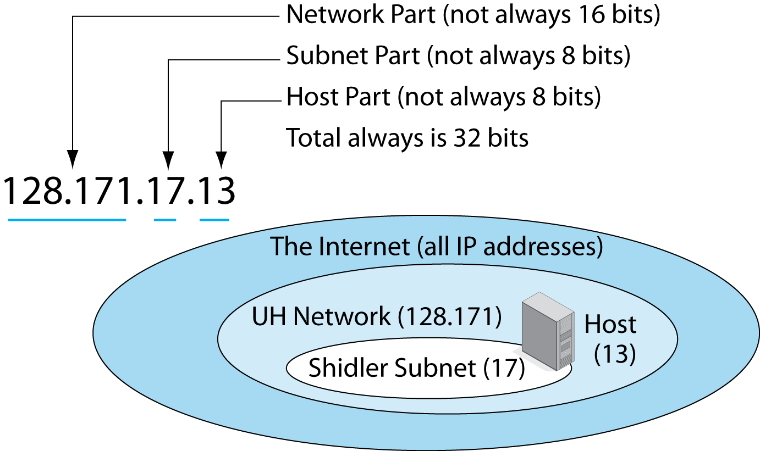
8.3: Hierarchical IP Address
An IP address usually has three parts.

Slide 12
8.3: Hierarchical IP Address
The network part is given to a firm, ISP, or other entity by a registered number provider.
The firm divides its address space into subnets.
On each subnet, the host part indicates a particular host.

Slide 13
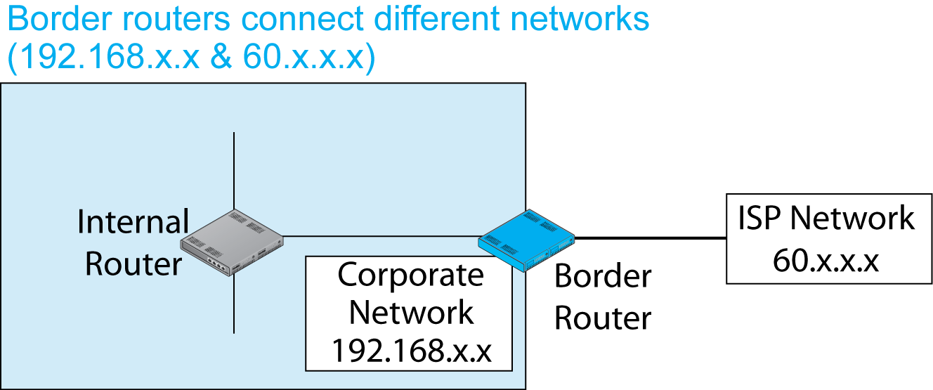
8.4: Border Router, Internal Router, Networks, and Subnets

Slide 14
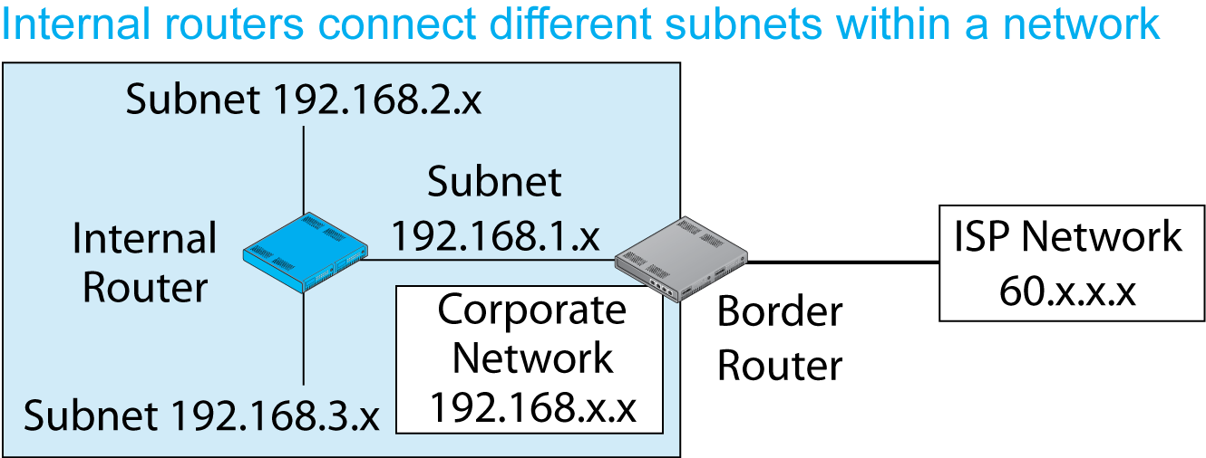
8.4: Border Router, Internal Router, Networks, and Subnets

Slide 15
8.5: IP Network and Subnet Masks
The Problem
There is no way to tell by looking at an IP address the sizes of the network, subnet, and host parts individually—only that their total is 32 bits.
The solution: masks.

Slide 16
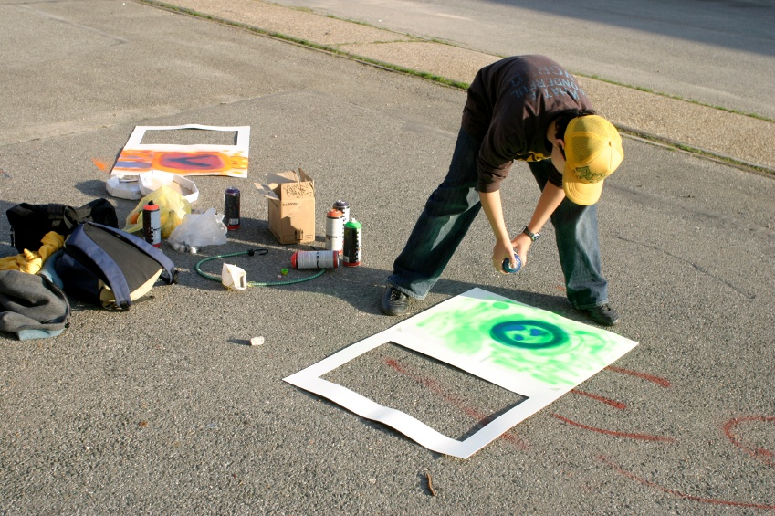
8.5: IP Network and Subnet Masks
Masks
In spray painting, you often use a mask (stencil).
The mask allows part of the paint through but stops the rest from going through.
Network and subnet masks do something similar.

Slide 17
8.5: IP Network and Subnet Masks
The solution: masks
A mask is a series of initial ones followed by series of final zeros, for a total of 32 bits.
Example 1: Sixteen 1s followed by Sixteen 0s
11111111 11111111 00000000 00000000
Eight 1s is 255 in dotted decimal notation.
Eight 0s is 0 in dotted decimal notation.
In dotted decimal notation, 255.255.0.0.
In prefix notation, /16.

Slide 18
8.5: IP Network and Subnet Masks
The solution: masks
A mask is a series of initial ones followed by series of final zeros, for a total of 32 bits.
Example 2: Twenty-four 1s followed by eight 0s
11111111 11111111 11111111 00000000
Eight 1s is 255 in dotted decimal notation.
Eight 0s is 0 in dotted decimal notation.
In dotted decimal notation, 255.255.255.0.
In prefix notation, /24.

Slide 19
8.5: IP Network and Subnet Masks
The solution: masks
Your turn.
Draw the 32 bits of the mask /14. Do not do it in dotted decimal notation. Write the bits in groups of eight. Here’s a start:
11111111 11

Slide 20
8.5: IP Network and Subnet Masks
Network Mask | Dotted Decimal Notation
Destination IP Address | 128 | 171 | 17 | 13
Network Mask (/16) | 255 | 255 | 0 | 0
Bits in network part, followed by zeros | 128 | 171 | 0 | 0

Slide 21
8.5: IP Network and Subnet Masks
Subnet Mask | Dotted Decimal Notation
Destination IP Address | 128 | 171 | 17 | 13
Subnet Mask (/24) | 255 | 255 | 255 | 0
Bits in network part, followed by zeros | 128 | 171 | 17 | 0

Slide 22
Recap of TCP/IP Concepts
Hierarchical IP Addresses
Router Operation
IPv4 and IPv6
TCP and UDP
TCP/IP Supervisory Standards

Slide 23
Router Operation
We have talked about routers since Chapter 1.
Now we will finally see what they do.
We will see what happens after a packet addressed to a particular IP address arrives.
But we will first recap how Ethernet switches handle arriving frames.

Slide 24
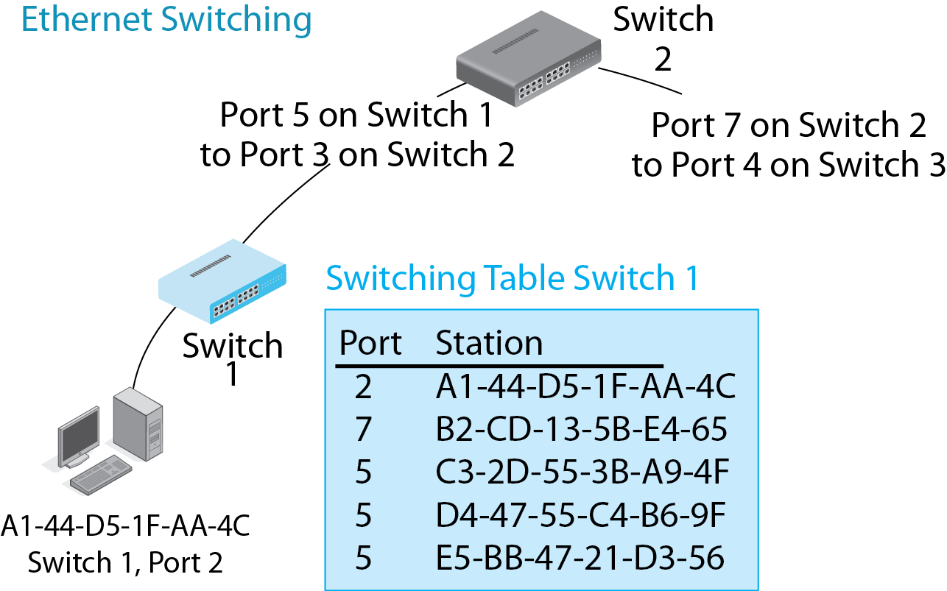
8.6: Ethernet Switching versus IP Routing
Ethernet switches are organized in a hierarchy, so there is only one possible port to send a frame out and so only one row per address.

Slide 25
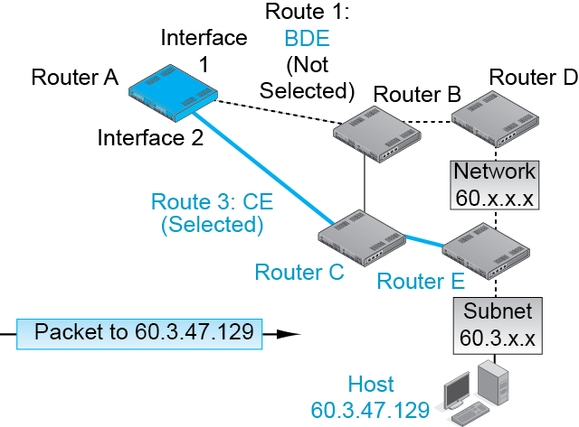
8.6: Ethernet Switching versus IP Routing
Routers are arranged in meshes with multiple alternative routes.
So a router may send a packet out more than one interface (port) and still get the packet to its destination host.

Slide 26
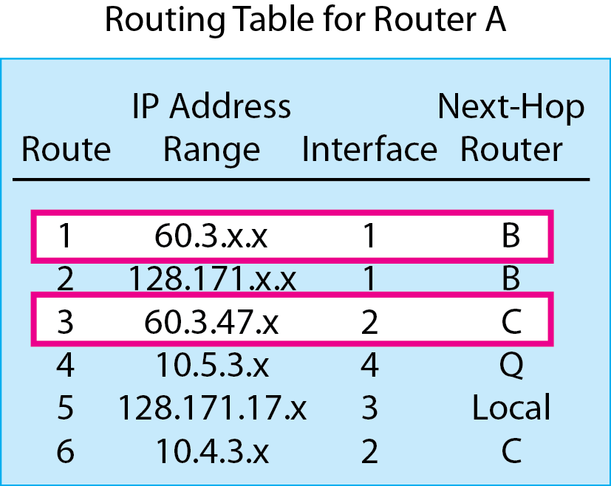
8.6: Ethernet Switching versus IP Routing
So in routing tables, multiple rows may give conflicting information about what to do with a packet.

Slide 27
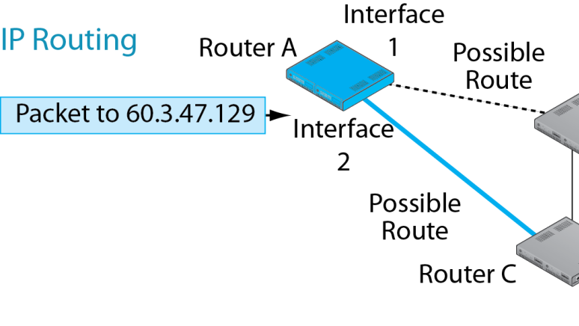
8.7: The Routing Process
Routing
Processing an individual packet and passing it on its way is called routing.

Slide 28
8.7: The Routing Process
The Routing Table
Each router has a routing table that it uses to make routing decisions.
Routing Table Rows
Each row represents a route for a range of IP addresses— often packets going to the same network or subnet.

Slide 29

8.7: The Routing Process
Ethernet switching table rows are rules for handling individual Ethernet MAC addresses.
Router routing table rows are rules for handling ranges of IP addresses.

Slide 30
Routing Table Columns
Column | Meaning
Row Number | Designates the row in the routing table
Destination | Range of IP addresses governed by the row
Mask | Mask for the row
Metric | Quality of the route listed in this row
Interface | The interface (port) to use to send the packet out
Next-Hop Router | The device (router or destination host) on the interface subnet to receive the packet

Slide 31
8.8: Routing Table
Row | Destination Network or Subnet | Mask (/Prefix) | Metric (Cost) | Interface | Next-Hop Router
1 | 127.171.0.0 | 255.255.0.0 (/16) | 47 | 2 | G
2 | 172.30.33.0 | 255.255.255.0 (/24) | 0 | 1 | Local
3 | 60.168.6.0 | 255.255.255.0 (/24) | 12 | 2 | G
4 | 123.0.0.0 | 255.0.0.0 (/8) | 33 | 2 | G
5 | 172.29.8.0 | 255.255.255.0 (/24) | 34 | 1 | F
6 | 172.40.6.0 | 255.255.255.0 (/24) | 47 | 3 | H
7 | 128.171.17.0 | 255.255.255.0 (/24) | 55 | 3 | H
8 | 172.29.8.0 | 255.255.255.0 (/24) | 20 | 3 | H

Slide 32
8.8: Routing Table
Row | Destination Network or Subnet | Mask (/Prefix) | Metric (Cost) | Interface | Next-Hop Router
9 | 172.12.6.0 | 255.255.255.0 (/24) | 23 | 1 | F
10 | 172.30.12.0 | 255.255.255.0 (/24) | 9 | 2 | G
11 | 172.30.12.0 | 255.255.255.0 (/24) | 3 | 3 | H
12 | 60.168.0.0 | 255.255.0.0 (/16) | 16 | 2 | G
13 | 0.0.0.0 | 0.0.0.0 (/0) | 5 | 3 | H

Slide 33

8.7: The Routing Process
A Routing Decision
Whenever a packet arrives, the router looks at its IP address, then…
Step 1: Finds All Row Matches
Step 2: Finds the Best-Match Row
Step 3: Sends the Packet Back out According to Directions in the Best-Match Row

Slide 34
8.7: The Routing Process
Step 1: Finding All Row Matches
The router looks at the destination IP address in an arriving packet.
It matches this IP address against each row.
It begins with the first row.
It looks at every subsequent row.
It stops only after it looks at the last row.

Slide 35
8.7: The Routing Process
Step 1: Finding All Row Matches
Each row is a rule for routing packets within a range of IP addresses. The IP address range is indicated by a destination and a mask.
Row | Destination Network or Subnet | Mask
1 | 128.171.0.0 | /16
2 | 172.30.33.0 | /24
3 | 60.168.6.0 | /24

Slide 36
8.7: The Routing Process
Step 1: Finding All Row Matches
Each row is a rule for routing packets within a range of IP addresses.
The router has the IP address of an arriving packet.
It applies the mask in a row to the arriving IP address.
If the result is equal to the value in the destination column, then the IP address of the packet is in the row’s range. The row is a match.

Slide 37
8.7: The Routing Process
Example 1: A Destination IP Address that Is NOT in the Range of the Row
Dest. IP Address of Packet 60. 43. 7. 8
Apply the (Network) Mask 255.255. 0. 0
Result of Masking 60. 43. 0. 0
Destination Column Value 128.171. 0. 0
Does Destination Match the Masking Result? No
Conclusion: Not a Match

Slide 38
8.7: The Routing Process
Example 2: A Destination IP Address that IS in the Range of the Row
Dest. IP Address of Packet 128.171. 17. 13
Apply the (Network) Mask 255.255. 0. 0
Result of Masking 128.171. 0. 0
Destination Column Value 128.171. 0. 0
Does Destination Match the Masking Result? Yes
Conclusion: Is a Match

Slide 39

8.7: The Routing Process
Step 1: Finding All Row Matches
The router does this to ALL rows because there may be multiple matches.
Question 1: If there are 127,976 rows and the only rows that match are the second and seventh rows, what row will the router examine first?
Question 2: If there are 127,976 rows and the only rows that match are the second and seventh rows, how many rows will the router have to check to see if they match?

Slide 40
8.7: The Routing Process
A Routing Decision
Whenever a packet arrives, the router looks at its IP address, then…
Step 1: Finds All Row Matches
Step 2: Finds the Best-Match Row
Step 3: Sends the Packet Back out According to Directions in the Best-Match Row

Slide 41
8.7: The Routing Process
To find the best-match row, the router uses the mask column and perhaps the metric column.
Row | Mask | Metric (Cost)
1 | /16 | 47
2 | /24 | 0
3 | /24 | 12

Slide 42
8.7: The Routing Process
Step 2: Find the Best-Match Row
The router examines the matching rows it found in Step 1 to find the best-match row.
Basic Rule: it selects the row with the longest match (Initial 1s in the row mask).
Row 99 matches, mask is /16 (255.255.0.0)
Row 78 matches, mask is /24 (255.255.255.0)
Select Row 78 as the best-match row.

Slide 43
8.7: The Routing Process
Step 2: Find the Best-Match Row
Basic Rule: it selects the row with the longest match (Initial 1s in the row mask).
Tie Breaker: if there is a tie for longest match, select among the tie rows based on metric.
There is a tie for longest length of match.
Row 668 has match length /16, cost metric = 20.
Row 790 has match length /16, cost metric = 16.
Router selects 790, which has the lowest cost.

Slide 44
8.7: The Routing Process
Step 2: Find the Best-Match Row
Basic Rule: it selects the row with the longest match (Initial 1s in the row mask).
Tie Breaker: if there is a tie on longest match, select among the tie rows based on metric.
There is a tie for longest length of match.
Row 668 has match /16, speed metric = 20.
Row 790 has a match /16, speed metric = 16.
Router selects 668, which has the highest speed.

Slide 45
8.7: The Routing Process
Step 2: Find the Best-Match Row
The following rows are matches.
Row / Mask / Metric
220 /24 / speed metric = 40
345 /18 / speed metric = 50
682 /8 /speed metric = 40
Question: What is the best-match row? Why?

Slide 46
8.7: The Routing Process
Step 2: Find the Best-Match Row
The following rows are matches.
Row / Mask / Metric
107 / 12 / speed metric = 30
220 / 14 / speed metric = 100
345 / 18 / speed metric = 50
682 / 18 / speed metric = 40
Question: What is the best-match row? Why?

Slide 47
8.7: The Routing Process
Step 2: Find the Best-Match Row
The following rows are matches.
Row / Mask / Metric
107 / 12 / cost metric = 30
220 / 14 / cost metric = 100
345 / 18 / cost metric = 50
682 / 18 / cost metric = 40
Question: What is the best-match row? Why?

Slide 48
8.7: The Routing Process
A Routing Decision
Whenever a packet arrives, the router looks at its IP address, then…
Step 1: Finds All Row Matches
Step 2: Finds the Best-Match Row
Step 3: Sends the Packet Back out According to Directions in the Best-Match Row

Slide 49
8.7: The Routing Process
Router Port = Interface
Step 3: Send the Packet Back out
Send the packet out the router interface (port) designated in the best-match row.
Send the packet to the router in the next-hop router column.
Row | Interface | Next-Hop Router
1 | 2 | G
2 | 1 | Local
3 | 2 | H

Slide 50
8.7: The Routing Process
Step 3: Send the Packet Back out
If the address says Local, the destination host is out that interface.
Sends the packet to the destination IP address in a frame.
Row | Interface | Next-Hop Router
1 | 2 | G
2 | 1 | Local
3 | 2 | H

Slide 51
8.7: The Routing Process
Recap
A Routing Decision
Whenever a packet arrives, the router looks at its IP address, then…
Step 1: Finds All Row Matches
Step 2: Finds the Best-Match Row
Step 3: Sends the Packet Back out According to Directions in the Best-Match Row

Slide 52
Decision Caching (Cheating)
We have said consistently that the router must look at all rows when it receives an incoming packet.
That was, to use a technical term, a lie.
Some routers remember decisions and put them in a list called a cache.
If an incoming destination IP address matches an IP address range in the cache, the same decision is used.

Slide 53
Decision Caching (Cheating)
However, caching is dangerous.
The Internet changes all the time.
A cache-based decision may be inefficient or even wrong.
If caching is done, cached entries should be deleted very quickly after they are created.

Slide 54
8.9: Masks that Don’t End at 8-Bit Boundaries
So far, all of the masks we have seen have broken the network, subnet, and host parts at 8-bit boundaries.
This was done for ease of reading in dotted decimal notation.
However, mask parts often do not break at 8-bit boundaries.
The solution: Work in binary, not dotted decimal notation.
Box

Slide 55
8.9: Masks that Don’t End at 8-Bit Boundaries
Box
IP address = 3.143.12.12
Mask = 255.248.0.0
Destination Value = 3.264.0.0
Is this a match?

Slide 56
8.9: Masks that Don’t End at 8-Bit Boundaries
The solution: Work in binary, not dotted decimal notation
IP address = 3.143.12.12
00000011 10001111 00001100 00001100
Mask = 255.248.0.0
11111111 11111000 00000000 00000000
Destination Value = 3.264.0.0
00000011 10001000 00000000 00000000
Box

Slide 57
8.9 Masks that Don’t End at 8-Bit Boundaries
 | Octet 1 | Octet 2 | Octet 3 | Octet 4
IP Address | 00000011 | 10001111 | 00001100 | 00001100
Mask | 11111111 | 11111000 | 00000000 | 00000000
Result | 00000011 | 10001000 | 00000000 | 00000000
Destination | 00000011 | 10001000 | 00000000 | 00000000
The result and the destination match!
So this row is a match.
Box

Slide 58

8.10: Address Resolution Protocol (ARP)
Box
The Problem
The router wants to send the packet to a next-hop router or to the destination host.
The router knows the destination IP address of the NHR or destination host.
But it must send the packet in a frame suitable for that subnet.
The router does not know the destination device’s data link layer address.
It must learn it using the address resolution protocol (ARP).
Packet
Frame

Slide 59
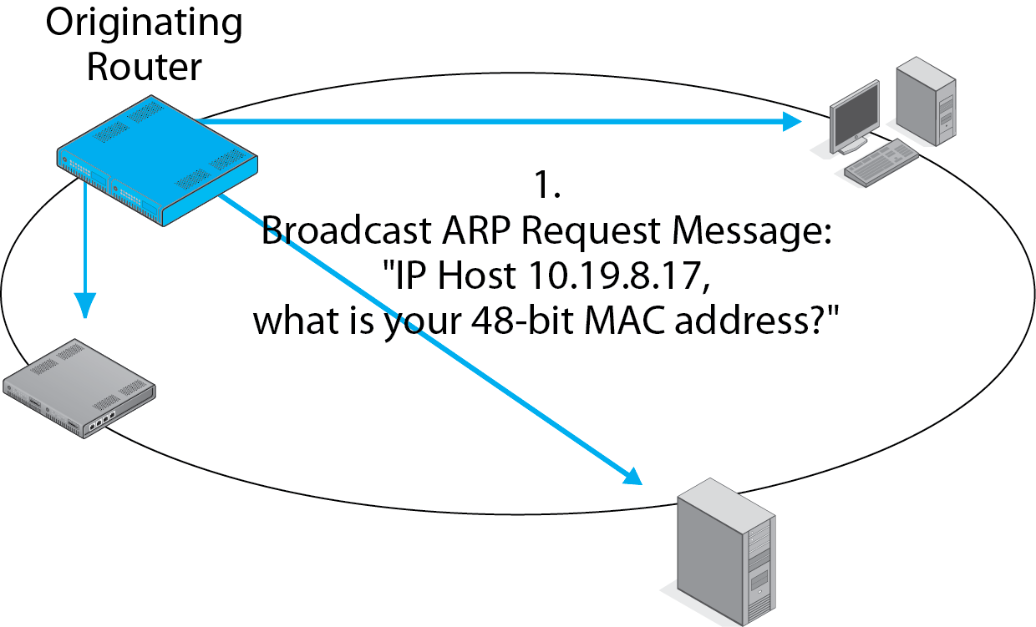
8.10: Address Resolution Protocol (ARP)
Box

Slide 60
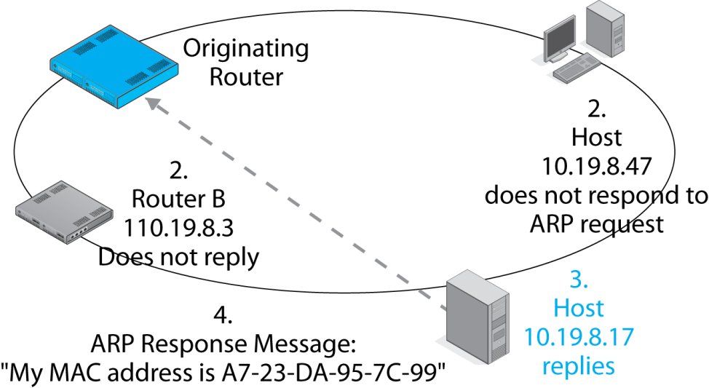
8.10: Address Resolution Protocol (ARP)
Box

Slide 61
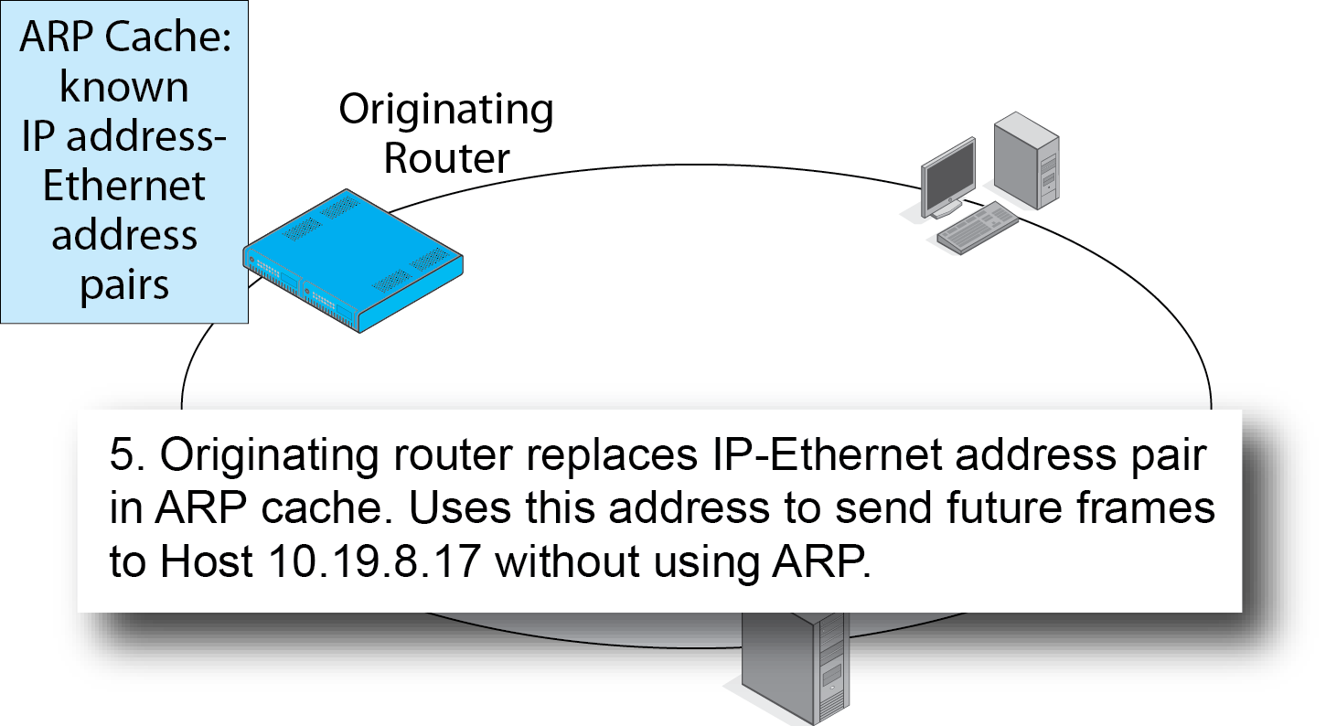
8.10: Address Resolution Protocol (ARP)
Box

Slide 62
Recap of TCP/IP Concepts
Hierarchical IP Addresses
Router Operation
IPv4 and IPv6
Multiprotocol Label Switching (MPLS)
TCP
TCP/IP Supervisory Standards

Slide 63
8.11: IPv4 Packet
Bit 0
IP Version 4 Packet
Bit 31
Version
(4 bits)
Value
is 4
(0100)
Header
Length
(4 bits)
Diff-Serv
(8 bits)
Total Length
(16 bits)
Length in octets
IPv4 is the dominant version of IP today.
The version number in its header is 4 (0100).
The Header Length and Total Length fields tell the size
of the packet.
The Diff-Serv (Differentiated Services) field can be used
for quality of service labeling.
Identification (16 bits)
Unique value in each original
IP packet
Flags
(3 bits)
Fragment Offset (13 bits)
Octets from start of
original IP fragment’s
data field
Time to Live
(8 bits)
Protocol (8 bits)
1=ICMP, 6=TCP,
17=UDP
Header Checksum
(16 bits)

Slide 64
8.11: IPv4 Packet
Bit 0
The second row is used for reassembling
fragmented IP packets, but IP fragmentation
is quite rare, so we will not look at
these fields.
IP Version 4 Packet
Bit 31
Version
(4 bits)
Value
is 4
(0100)
Header
Length
(4 bits)
Diff-Serv
(8 bits)
Total Length
(16 bits)
Length in octets
Identification (16 bits)
Unique value in each original
IP packet
Flags
(3 bits)
Fragment Offset (13 bits)
Octets from start of
original IP fragment’s
data field
Time to Live
(8 bits)
Protocol (8 bits)
1=ICMP, 6=TCP,
17=UDP
Header Checksum
(16 bits)
© 2013 Pearson Education, Inc. Publishing as Prentice Hall

Slide 65
8.11: IPv4 Packet
Bit 0
IP Version 4 Packet
The sender sets the Time-to-Live value (usually 64
to 128). Each router along the way decreases the
value by one. A router decreasing the value to zero
discards the packet. It may send an ICMP error
Message (discussed later).
Bit 31
Version
(4 bits)
Value
is 4
(0100)
Header
Length
(4 bits)
Diff-Serv
(8 bits)
Total Length
(16 bits)
Length in octets
Identification (16 bits)
Unique value in each original
IP packet
Flags
(3 bits)
Fragment Offset (13 bits)
Octets from start of
original IP fragment’s
data field
Time to Live
(8 bits)
Protocol (8 bits)
1=ICMP, 6=TCP,
17=UDP
Header Checksum
(16 bits)
© 2013 Pearson Education, Inc. Publishing as Prentice Hall

Slide 66
8.11: IPv4 Packet
Bit 0
IP Version 4 Packet
Bit 31
Version
(4 bits)
Value
is 4
(0100)
Header
Length
(4 bits)
Diff-Serv
(8 bits)
Total Length
(16 bits)
Length in octets
The Protocol field describes the message in the
data field (1 = ICMP, 6 = TCP, 17 = UDP, etc).
Identification (16 bits)
Unique value in each original
IP packet
Flags
(3 bits)
Fragment Offset (13 bits)
Octets from start of
original IP fragment’s
data field
Time to Live
(8 bits)
Protocol (8 bits)
1=ICMP, 6=TCP,
17=UDP
Header Checksum
(16 bits)
© 2013 Pearson Education, Inc. Publishing as Prentice Hall

Slide 67
8.11: IPv4 Packet
Bit 0
IP Version 4 Packet
Bit 31
As we saw in earlier chapters, the Header Checksum
field is used to find errors in the IP packet header.
If a packet has an error, the router drops it.
There is no retransmission at the internet layer,
so the internet layer is still unreliable.
Version
(4 bits)
Value
is 4
(0100)
Header
Length
(4 bits)
Diff-Serv
(8 bits)
Total Length
(16 bits)
Length in octets
Identification (16 bits)
Unique value in each original
IP packet
Flags
(3 bits)
Fragment Offset (13 bits)
Octets from start of
original IP fragment’s
data field
Time to Live
(8 bits)
Protocol (8 bits)
1=ICMP, 6=TCP,
17=UDP
Header Checksum
(16 bits)
© 2013 Pearson Education, Inc. Publishing as Prentice Hall

Slide 68
8.11: IPv4 Packet
Bit 0
IP Version 4 Packet
Bit 31
Source IP Address (32 bits)
Destination IP Address (32 bits)
Options (if any)
Padding
Data Field
The Source and Destination IP Addresses
are 32 bits long, as you would expect.
Options can be added, but these are rare
and may indicate a malicious packet.
© 2013 Pearson Education, Inc. Publishing as Prentice Hall

Slide 69
Outgrowing IPv4
IPv4 32-bit addresses allow more than 4 billion addresses.
However, addresses were given out by the Internet Assigned Number Authority (IANA) in chunks.
Today, only 14% of IPv4 addresses are in use, but we have run out of IPv4 addresses to assign to new organizations and ISPs.

Slide 70
Outgrowing IPv4
IPv6, fortunately, has 128-bit addresses.
This is an enormous address space.
IPv6 traffic is still very small.
However, firms must plan to support IPv6 now.
Graduates need a solid understanding of IPv6.

Slide 71
Writing IPv6 Addresses
IPv4 addresses are written in dotted decimal notation.
Divide the 32-bit address into four 8-bit segments.
Convert each segment to a decimal number.
Place dots between the segments.

Slide 72
Writing IPv6 Addresses
IPv6 addresses are written in hexadecimal
Divide the 128-bit address into eight 16-bit segments.
Convert each nibble (group of four bits) in each segment to hex in lower case.
Separate segments by colons.
2001:0027:fe56:0000:0000:0000:cd3f:0fca

Slide 73
Writing IPv6 Addresses
There are rules to shorten this notation.
Leading zeroes in each segment can be dropped.
A segment with 4 zeroes had 4 leading zeroes.
2001:0027:fe56:0000:0000:0000:cd3f:0fca
2001:27:fe56::::cd3f:fca

Slide 74
Writing IPv6 Addresses
If there is a single set of consecutive segments that are all zeroes, only the outer colons are kept.
2001:27:fe56::::cd3f:fca
2001:27:fe56::cd3f:fca

Slide 75
Writing IPv6 Addresses
What if there is more than one consecutive group of segments that is all zeroes?
Remove inner colons in the longest one.
Do not remove any other inner colons.
2001:0000:0000:dfca:0000:0000:0000:cd3f
2001:::dfca::cd3f

Slide 76
Writing IPv6 Addresses
What if there is a tie for the longest group of all-zero segments?
Remove the inner colons from the first one
2001:0000:0000:dfca:0000:0000:abcd:cd3f
2001::dfca:::abcd:cd3f

Slide 77
Writing IPv6 Addresses (Recap)
Group the bits into segments of 16 bits.
Convert each pair to a hex symbol.
Write letter symbols in lower case.
Place colons between each pair of segments.
Remove initial zeroes in each segment.
If there are is a group of segments with all zeroes, remove the inner colons.
Only do this to one segment—the longest one (or the first if there is a tie for longest).

Slide 78
8.12: IPv6 Packet Header
Bit 0
IP Version 6 Packet
Bit 31
Version
(4 bits)
Value
is 6
(0110)
Diff-Serv
(8 bits)
Flow Label (20 bits)
Marks a packet as part of a specific flow
Source and Destination Addresses
are 128 bits long.
Payload Length
(16 bits)
Next Header
(8 bits) Name
of next header
Hop Limit
(8 bits)
Source IP Address (128 bits)
Destination IP Address (128 bits)
Next Header or Payload (Data Field)
© 2013 Pearson Education, Inc. Publishing as Prentice Hall

Slide 79
8.12: IPv6 Packet Header
IP Version 4
32-bit addresses
2³² possible addresses
4,294,967,296 (about 4 billion)
Running out of these
IP Version 6
128-bit addresses
2¹²⁸ possible addresses
340,282,366,920,938,000,000,000,000,000,000,000,000 addresses

Slide 80
8.12: IPv6 Packet Header
Where’s all that fragmentation stuff from IPv4?
Gone, fragmentation is not done in IPv6.
What if a packet is too big for a network along the way?
It is discarded.
So the sending host first determines the MTU (maximum transmission unit)—largest packet size along the route—before transmission.

Slide 81
8.12: IPv6 Packet Header
Hey, where is the Header Checksum?
Gone, let the transport layer worry about errors.
This avoids the work of error checking on each router along the way.
Reduces per-packet routing time.

Slide 82
8.12: Next Headers in IPv6 Packet Headers
Bit 0
IP Version 6 Packet
Bit 31
Version
(4 bits)
Value
is 6
(0110)
Diff-Serv
(8 bits)
Flow Label (20 bits)
Marks a packet as part of a specific flow of packets
Payload Length
(16 bits)
Next Header
(8 bits) Name
of next header
Hop Limit
(8 bits)
Source IP Address (128 bits)
IPv6 has many subheaders,
each is linked to the next
via the Next Header field
Destination IP Address (128 bits)
Next Header or Payload (Data Field)
© 2013 Pearson Education, Inc. Publishing as Prentice Hall

Slide 83
8.13: Next Headers in IPv6 Packet Headers
Main Header
0
Next Header
Hop-by-Hop Options Header (0)
6
Next Header
TCP Segment (6)

Slide 84
8.14: IPv6 Next Header Values
Header Type | Value
Extension Header
Hop-by-Hop Options Header | 0
Routing Header | 43
Fragmentation Header | 44
Authentication Header | 51
Encapsulating Security Protocol Header | 50
Destination Options Header | 60
Mobility Header | 135
No Next Header | 59

Slide 85
8.14: IPv6 Next Header Values
Header Type | Value
Upper Layer messages
TCP | 6
UDP | 17
ICMPv6 | 58

Slide 86
Recap of TCP/IP Concepts
Hierarchical IP Addresses
Router Operation
IPv4 and IPv6
TCP and UDP
TCP/IP Supervisory Standards

Slide 87
8.15: TCP and UDP
TCP Process
Receives an application message from the application layer process
Fragments the application message into segments
Sends each segment in a separate IP packet

Slide 88
8.15: TCP and UDP
TCP Process
Places a sequence number in each segment.
Receiver uses these sequence numbers to defragment the application message.
When receiver receives a TCP segment correctly, it sends back an acknowledgement segment.
This acknowledgement segment has an acknowledgement number that indicates which segment is being acknowledged.

Slide 89
8.15: TCP and UDP
UDP Process
Does not do fragmentation.
Does not need sequence numbers, acknowledgement numbers, or acknowledgements.
This simplifies UDP.
However, the entire application message must fit in a single UDP datagram field—a maximum size of 65,536 octets.

Slide 90
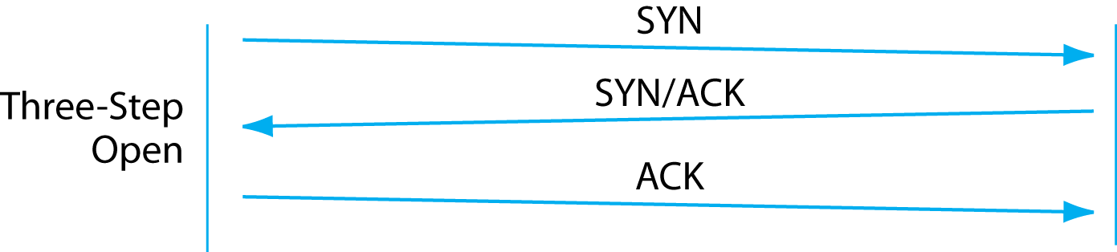
8.16: TCP Session Openings and Closings
Normal TCP Open
(from Chapter 2)

Slide 91
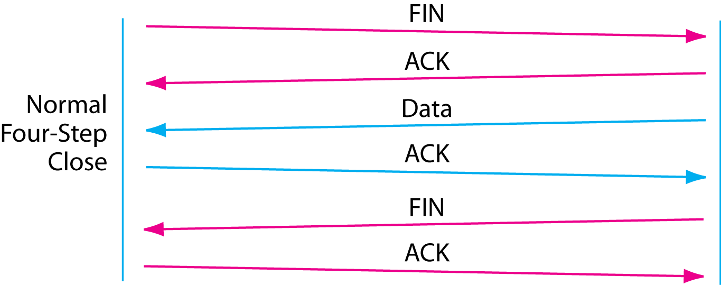
8.16: TCP Session Openings and Closings
Normal TCP Close
(also from Chapter 2)

Slide 92
8.16: TCP Session Openings and Closings
Abrupt TCP Close
closes the connection immediately.
Other side does not acknowledge.

Slide 93
Recap of TCP/IP Concepts
Hierarchical IP Addresses
Router Operation
IPv4 and IPv6
TCP and UDP
TCP/IP Supervisory Standards

Slide 94
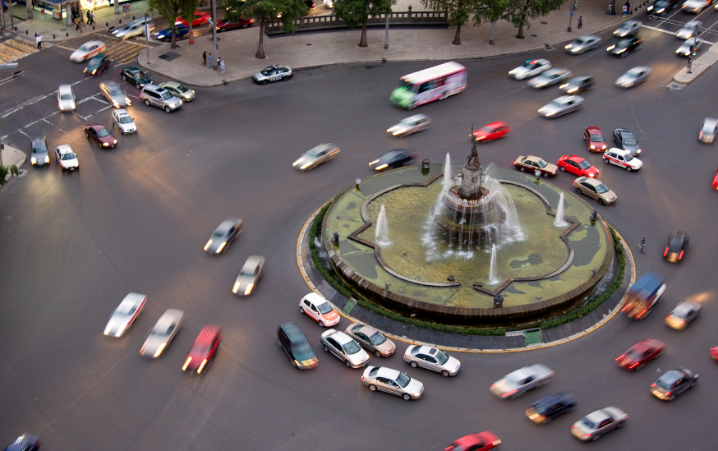
TCP/IP Supervisory Protocols
In addition to IP, TCP, UDP, and user application protocols, TCP/IP has many supervisory protocols to help manage internets.

Slide 95
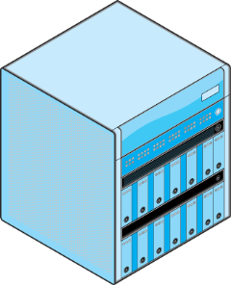
TCP/IP Supervisory Protocols
Dynamic routing protocols allow routers to share routing table information. Dynamic routing protocols are the ways routers normally get the information in their routing tables.
Routing Table
Information
Router
Router

Slide 96
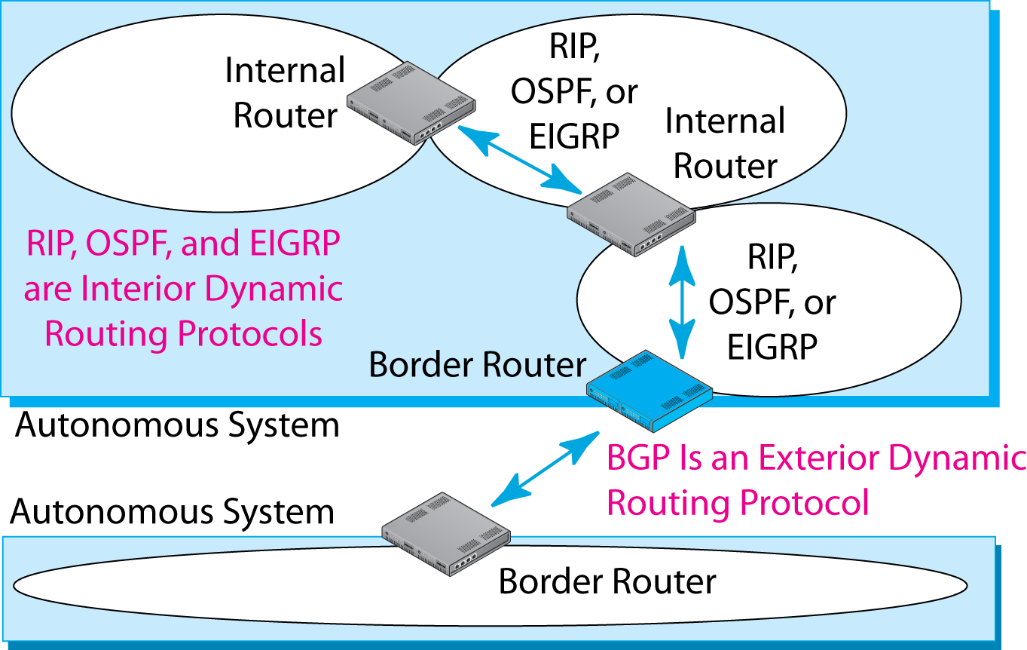
8.17: Dynamic Routing Protocols

Slide 97
8.17: Dynamic Routing Protocols

Slide 98
8.18: Dynamic Routing Protocols
Dynamic Routing Protocol | Interior or Exterior Routing Protocol? | Remarks
RIP (Routing Information Protocol) | Interior | Only for small autonomous systems with low needs for security
OSPF (Open Shortest Path First) | Interior | For large autonomous systems that use only TCP/IP
EIGRP (Enhanced Interior Gateway Routing Protocol) | Interior | Proprietary Cisco Systems protocol. Not limited to TCP/IP routing. Also handles IPX/SPX, SNA, and so forth.

Slide 99
8.18: Dynamic Routing Protocols
Dynamic Routing Protocol | Interior or Exterior Routing Protocol? | Remarks
BGP (Border Gateway Protocol) | Exterior | Organization cannot choose what exterior routing protocol it will use

Slide 100
Routing
The term routing is used two ways in TCP/IP.
Routing is the process that routers use to forward incoming packets.
Routing is the exchange of routing table information through routing protocols.

Slide 101
TCP/IP Supervisory Protocols
Internet Control Message Protocol (ICMP)
A general protocol for sending control information between routers and hosts
Error messages
Pings (Echo messages)
And so on
Supplements IP packet forwarding with supervisory information
IP is RFC 791; ICMP is RFC 792

Slide 102
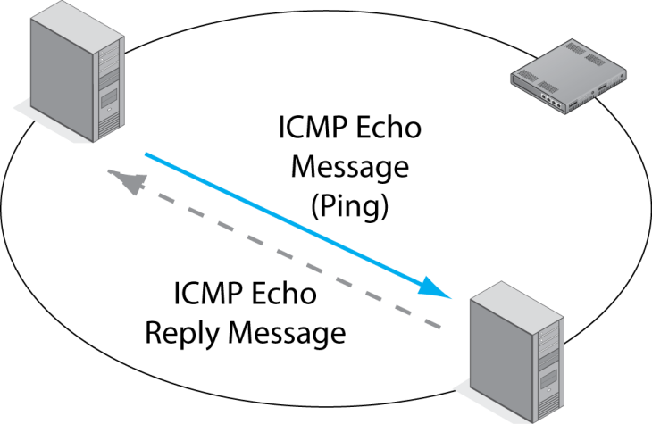
8.19: Internet Control Message Protocol (ICMP)

Slide 103
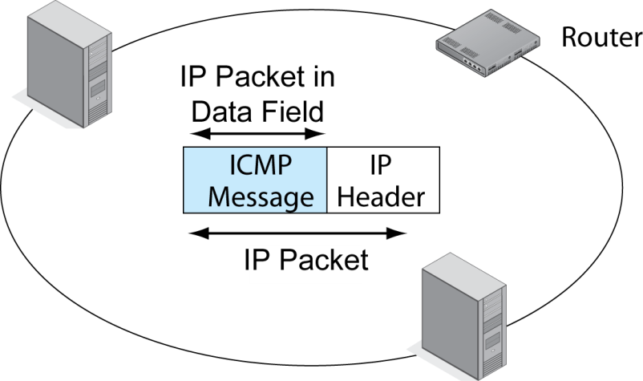
8.19: Internet Control Message Protocol (ICMP)

Slide 104
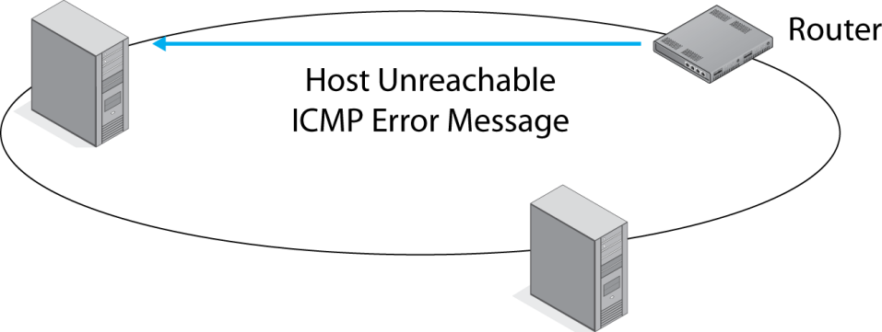
8.19: Internet Control Message Protocol (ICMP)
Source
Host

Slide 105

TCP/IP Internetworking II
Chapter 9
Panko and Panko
Business Data Networks and Security, 9th Edition
© 2013 Pearson Education, Inc. Publishing as Prentice Hall

Slide 106
Perspective
Chapter (s) | Coverage | Layers
1–4 | Core concepts and principles | All
5 | Single switched networks | 1–2
6–7 | Single wireless networks | 1–2
8–9 | Internets | 3–4
10 | Wide Area Networks | 1-4
11 | Applications | 5

Slide 107
Perspective
Chapter 8
Major TCP/IP standards
Router operation
Chapter 9
Managing Internets
Securing Internets

Slide 108
IP Subnetting
Network Address Translation (NAT)
DNS and DHCP
SNMP
Multiprotocol Label Switching
Securing Internet Transmission
IPv6 Management

Slide 109
9.1: IPv4 Subnetting
Companies are given host parts by their ISP or an Internet number authority.
They divide the remaining bits between a subnet part and a host part.
Larger subnet parts mean more subnets, but this results in smaller host parts, which means fewer hosts per subnet.
The reverse is also true.

Slide 110
9.1: IPv4 Subnetting
If a part has N bits, it can represent 2^{N} - 2 subnets or hosts per subnet.
2^{N} because if you have N bits, you can represent 2^{N} possibilities.
Minus 2 is because you cannot have a part that is all zeros or all ones.
Part Size
(bits)
2^{N}
2^{N}-2
4
2⁴ = 16
16-2 = 14
8
?
?
10
?
?
12
4,096
4,094
16
65,536
65,534

Slide 111
9.1: IPv4 Subnetting
Step
Description
1
Total size of IP address
(bits)
32
By definition
2
Size of network part
assigned to firm (bits)
16
Assigned to
the firm
3
Remaining bits for firm
to assign
16
Bits for the
firm to assign
4
Selected subnet/host part
sizes (bits)
8 / 8
The firm’s
decision
Number of possible
subnets (2^{N} - 2)
254
(2⁸ - 2)
Number of possible hosts
per subnet (2^{N} - 2)
254
(2⁸ - 2)

Slide 112
9.1: IPv4 Subnetting
Step
Description
1
Total size of IP address
(bits)
32
By definition
2
Size of network part
assigned to firm (bits)
16
Assigned to
the firm
3
Remaining bits for firm to
assign
16
Bits for the
firm to assign
4
Selected subnet/host part
sizes (bits)
6/10
The firm’s
decision
Number of possible
subnets (2^{N} - 2)
62
(2⁶ - 2)
Number of possible hosts
per subnet (2^{N} - 2)
1,022
(2¹⁰ - 2)

Slide 113
9.1: IPv4 Subnetting
Step
Description
1
Total size of IP address
(bits)
32
By definition
2
Size of network part
assigned to firm (bits)
8
Assigned to
the firm
3
Remaining bits for firm to
assign
24
Bits for the
firm to assign
4
Selected subnet/host part
sizes (bits)
12/12
The firm’s
decision
Number of possible
subnets (2^{N} - 2)
4,094
(2¹² - 2)
Number of possible hosts
per subnet (2^{N} - 2)
4,094
(2¹² - 2)

Slide 114
9.1: IPv4 Subnetting
Step
Description
1
Total size of IP address
(bits)
32
By definition
2
Size of network part
assigned to firm (bits)
8
Assigned to
the firm
3
Remaining bits for firm to
assign
24
Bits for the
firm to assign
4
Selected subnet/host part
sizes (bits)
8/16
The firm’s
decision
Number of possible
subnets (2^{N} - 2)
254
(2⁸ - 2)
Number of possible hosts
per subnet (2^{N} - 2)
65,534
(2¹⁶ - 2)

Slide 115
IP Subnetting
Network Address Translation (NAT)
DNS and DHCP
SNMP
Multiprotocol Label Switching
Securing Internet Transmission
IPv6 Management

Slide 116
9.2: Network Address Translation (NAT)
NAT
Sends false external source IP addresses and port numbers that are different from internal source IP addresses and port numbers.
For security purposes.
To have many more internal IP addresses than your ISP gives you external IP addresses.

Slide 117
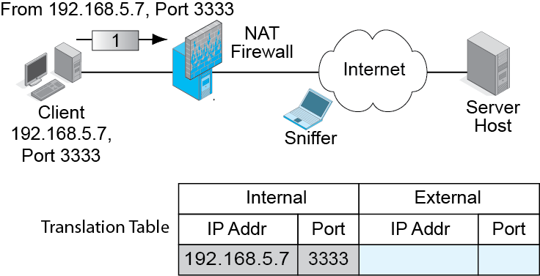
9.3: NAT Operation
NAT Firewall puts the real source IP address and port number in the table.

Slide 118
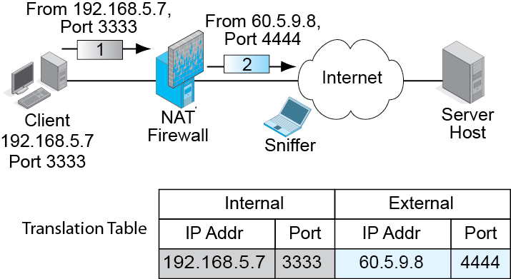
9.3: NAT Operation
NAT Firewall replaces the source IP address and port number of the packet with a false source IP address and port number.
Adds to table.

Slide 119
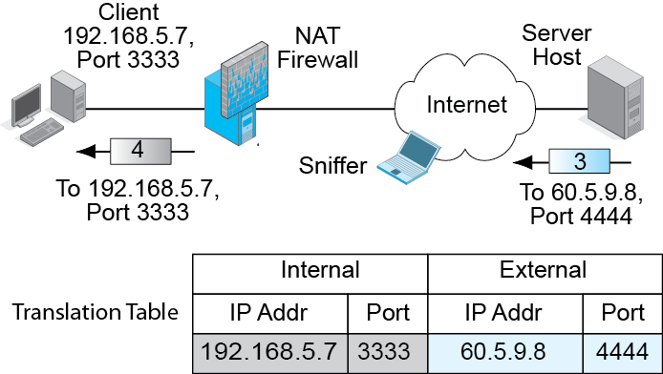
9.3: NAT Operation
NAT Firewall reverses the process for incoming packets.

Slide 120
9.2: Network Address Translation
NAT is Transparent to Internal and External Hosts.
The NAT firewall does all the work.
Neither host knows that NAT is taking place.
So there is no need to modify how hosts work.

Slide 121
9.2: Network Address Translation
Security Reasons for Using NAT
External attackers can put sniffers outside the corporation.
Sniffers read IP addresses and port numbers.
Attackers can send attacks to these addresses and port numbers.
With NAT, attackers learn only false external IP addresses. Cannot use this information to attack internal hosts.

Slide 122
9.2: NAT
Expanding the Number of Available IP Addresses
Companies may receive a limited number of IP addresses from their ISPs.
There are roughly 4,000 possible ephemeral port numbers for each client IP address.
So for each IP address, there can be up to about 4,000 external connections.
If a firm is given 248 IP addresses, there can be roughly one million external connections.

Slide 123
9.2: NAT
Expanding the Number of Available IP Addresses
If each internal device averages several simultaneous external connections, each one will require a different port number.
However, there should not be a problem with this many possible external IP addresses and port numbers.

Slide 124
9.2: NAT
Companies often use private IP addresses internally.
These can be used only within companies—never on the Internet.
There are three Private IP address ranges.
10.x.x.x
172.16.x.x through 172.31.x.x
192.168.x.x (most popular)

Slide 125
9.2: NAT
There Are Protocol Problems Caused by NAT
IPsec, VoIP, and other applications have a difficult time with NAT firewall traversal.
They must know the real IP address and port number of the host on the other side of the NAT firewall.
There are NAT firewall traversal techniques, but they must be managed carefully.

Slide 126
IP Subnetting
Network Address Translation (NAT)
DNS and DHCP
SNMP
Multiprotocol Label Switching
Securing Internet Transmission
IPv6 Management

Slide 127
The Domain Name System (DNS)

Slide 128
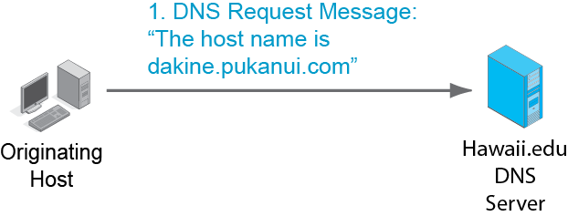
9.4: Domain Name System (DNS) Lookup
Originating host needs the IP address of host dakine.pukanui.com.
Asks its local DNS server at Hawaii.edu.

Slide 129
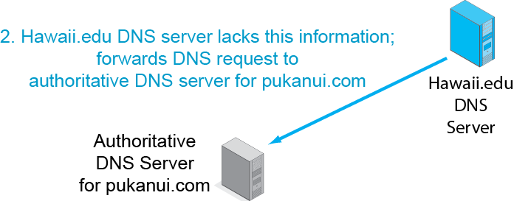
9.4: Domain Name System (DNS) Lookup

Slide 130
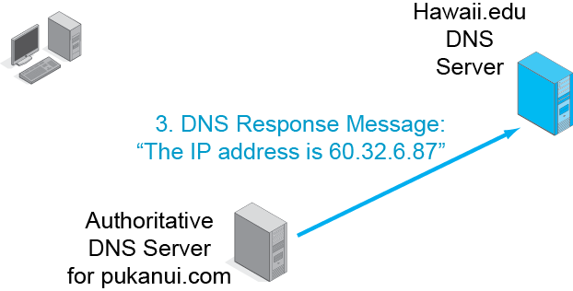
9.4: Domain Name System (DNS) Lookup
Sends response to local DNS server, not the client host.

Slide 131
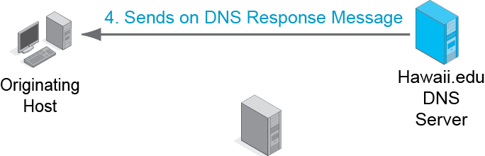
9.4: Domain Name System (DNS) Lookup
Note that the local DNS server always sends back the response message.

Slide 132
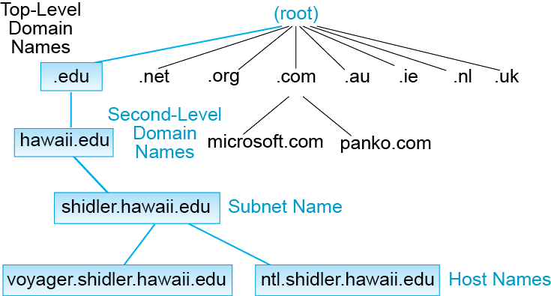
9.5: Domain Name System (DNS) Hierarchy
The DNS really is a general naming system for the Internet.
A domain is a set of resources under the control of an organization.
There is a hierarchy of domains.

Slide 133
9.5: Domain Name System (DNS) Hierarchy
The root is all domains.
There are 13 DNS root servers.

Slide 134
9.5: Domain Name System (DNS) Hierarchy
There are two kinds of top-level domains.
Generic top-level domains indicate organization type (.com, .edu, .gov, etc.).
Country top-level domains are specific to a country (.UK, .CA, .CH, etc.).

Slide 135
9.5: Domain Name System (DNS) Hierarchy
Traditionally, generic top-level domains were strongly limited in number.
There have been a few additions over the year, such as .museum, .name, and .co.
As of 2013, any individual or company can propose to administer a generic top-level domain.

Slide 136
9.5: Domain Name System (DNS) Hierarchy
Companies want second-level domain names.
(Microsoft.com, apple.com, panko.com, etc.).
Competition for these names is fierce.

Slide 137
9.5: Domain Name System (DNS) Hierarchy
Most companies divide their organizations into subdomains or subnets.

Slide 138
9.5: Domain Name System (DNS) Hierarchy
At the bottom of the hierarchy are individual hosts.

Slide 139
The Dynamic Host Configuration Protocol (DHCP)

Slide 140
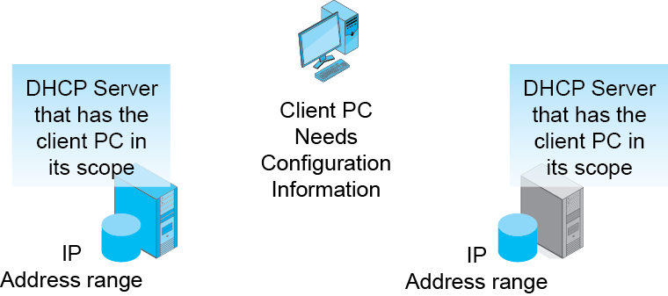
9.6: Dynamic Host Configuration Protocol (DHCP) Service

Slide 141
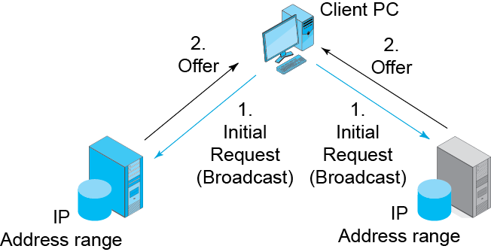
9.6: Dynamic Host Configuration Protocol (DHCP) Service

Slide 142
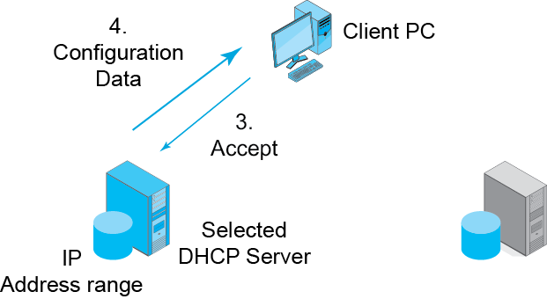
9.6: Dynamic Host Configuration Protocol (DHCP) Service

Slide 143
9.6: Dynamic Host Configuration Protocol (DHCP) Service
Typical configuration information:
IP address for the DHCP client to use
The subnet mask for the client’s subnets
The IP address of the client’s default router
The IP addresses of the firm’s multiple DNS servers

Slide 144
DNS versus DHCP
The two are often confused because both give a client PC an IP address.
DHCP gives a client PC its own dynamic IP address.
DNS gives a client PC the IP address of a host the client wishes to send packets to.

Slide 145
IP Subnetting
Network Address Translation (NAT)
DNS and DHCP
SNMP
Multiprotocol Label Switching
Securing Internet Transmission
IPv6 Management

Slide 146

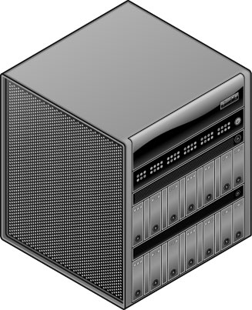


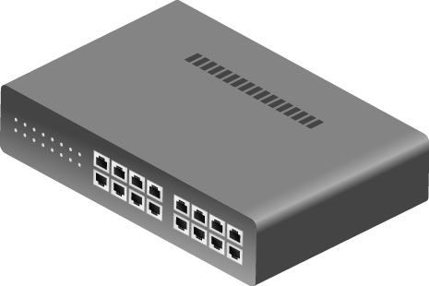
9.7: Simple Network Management Protocol (SNMP)
Core Elements (from Chapter 4)
Manager program
Managed device
Agents (communicate with the manager on behalf of the managed device)
Agents
Manager
Managed
Devices

Slide 147

9.7: Simple Network Management Protocol (SNMP)
Core Elements (from Chapter 4)
Management information base (MIB).
Stores the retrieved information.
“MIB” can refer to either the database on the manager or to the database schema.
Manager
MIB

Slide 148
9.7: Simple Network Management Protocol (SNMP)2
Messages
Commands (sent by a manager to an agent)
Get (to get information from the agent)
Set (to tell the agent to change how the managed devices is operating)
Responses (sent from agent to manager)
Get or Set Command
Response

Slide 149
9.7: Simple Network Management Protocol (SNMP)
Messages
Traps (alarms sent by agents).
SNMP uses UDP at the transport layer to minimize the burden on the network.
Trap

Slide 150
9.7: Simple Network Management Protocol (SNMP)
Set Commands
Dangerous if used by attackers.
Many firms disable Set to thwart such attacks.
However, they give up the ability to manage remote resources without travel.
SNMPv1: community string shared by the manager and all devices (poor).
SNMPv3: each manager–agent pair has a different password (good).

Slide 151
9.7: Simple Network Management Protocol (SNMP)
Objects (Figure 9-8)
Specific pieces of information
Number of rows in the routing table
Number of discards caused by lack of resources (indicates a need for an upgrade)
Objects are NOT managed devices!
Objects are specific pieces of data about a managed device.

Slide 152
9.7: Simple Network Management Protocol (SNMP)
Categories of Objects
System objects (one set per managed device)
System name
System description
System contact person
System uptime (since last reboot)

Slide 153
9.8: SNMP Object Model
Categories of Objects
IP objects (one set per managed device)
Forwarding (for routers), Yes if forwarding (routing), No if not
Cause of resource limitations
Number of rows in routing table
Rows discarded because of lack of space
Individual row data

Slide 154
9.8: SNMP Object Model
Categories of Objects
TCP objects (one set per managed device)
Retransmission time
Maximum number of TCP connections allowed
Opens/failed connections/resets
Segments sent
Segments retransmitted
Errors in incoming segments
Data on individual connections (sockets, states)

Slide 155
9.8: SNMP Object Model
Categories of Objects
UDP objects (one set per host)
Traffic statistics
ICMP objects (one set per host)
Number of ICMP errors of various types

Slide 156
9.8: SNMP Object Model
Categories of Objects
One set per managed device:
System
IP
TCP
UDP
ICMP
Interface objects: one set per interface (port)

Slide 157
9.8: SNMP Object Model
Categories of Objects
Interface objects (one set per interface)
Type (e.g., 69 is 100Base-FX; 71 is 802.11)
Status: up/down/testing
Speed
Errors: discards, unknown protocols, and so on

Slide 158
9.7: SNMP
SNMP Manager program collects data.
Places it in the MIB.
Visualization Program.
The administrator’s interface to the MIB.
Helps the administrator visualize patterns in the MIB data.
Can order the SNMP Manager to collect certain data or to send set commands to change the configurations of managed devices.

Slide 159
9.7: Simple Network Management Protocol (SNMP)
User Functionality
Reports, diagnostics tools, and so on, are very important.
They are not built into the standard.
They are added by network visualization program vendors.
Critical in selection of a network management vendor.

Slide 160
IP Subnetting
Network Address Translation (NAT)
DNS and DHCP
SNMP
Multiprotocol Label Switching
Securing Internet Transmission
IPv6 Management

Slide 161
Multiprotocol Label Switching
Routers route each packet individually, going through the three steps we saw in the last chapter.
Even if the next packet is going to the same destination IP address, the router will go through all three steps.
This consumes a great deal of processing power per packet.
This makes traditional routing expensive.

Slide 162
Multiprotocol Label Switching
MPLS addresses this issue.
Routers identify the best route for a range of IP addresses before sending data.
That route is given a label number.
Each packet in a stream gets a label with this label number.
Routers do only a quick table lookup per packet.
Table lookups require little processing power.
So multiprotocol label switching is much less expensive than traditional routing.

Slide 163
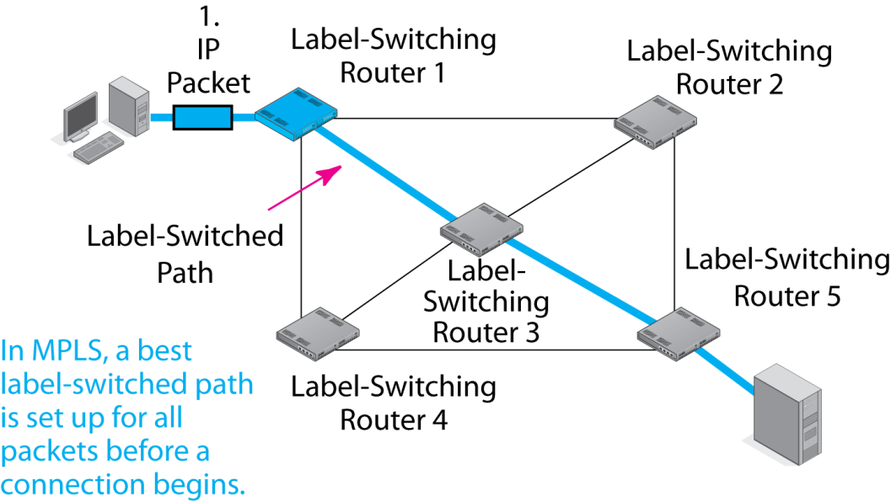
9.9: Multiprotocol Label Switching (MPLS)

Slide 164
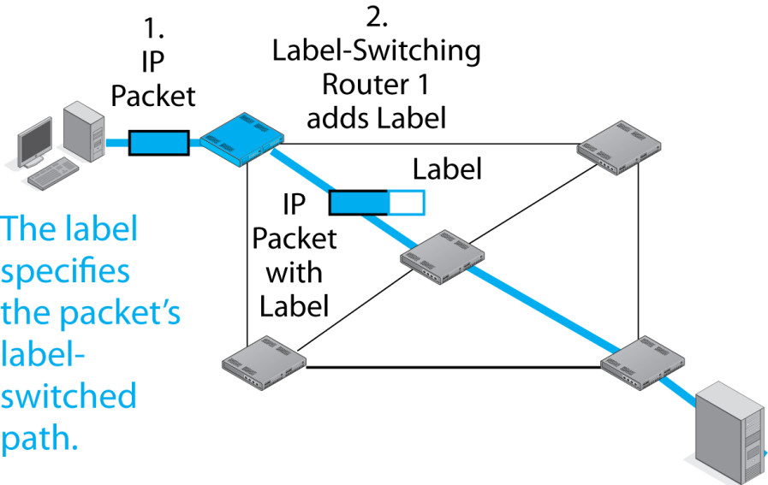
9.9: Multiprotocol Label Switching (MPLS)
Label Number is 123

Slide 165
9.9: MPLS
Label sits between the frame header and the IP packet header.
IP Packet
Header
MPLS Label
Frame Header

Slide 166
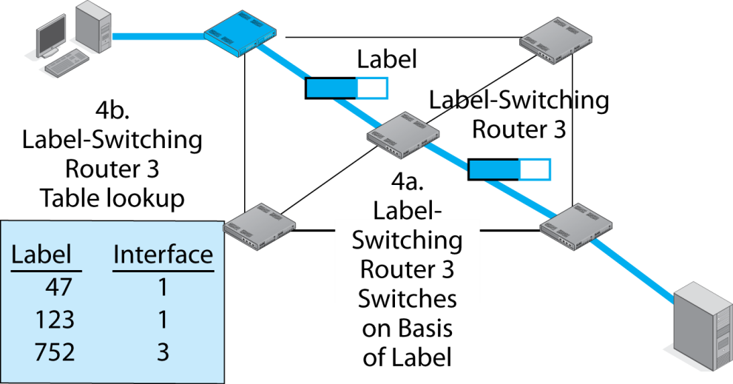
9.9: Multiprotocol Label Switching (MPLS)
Router 3 sends the packet out through Interface 1

Slide 167
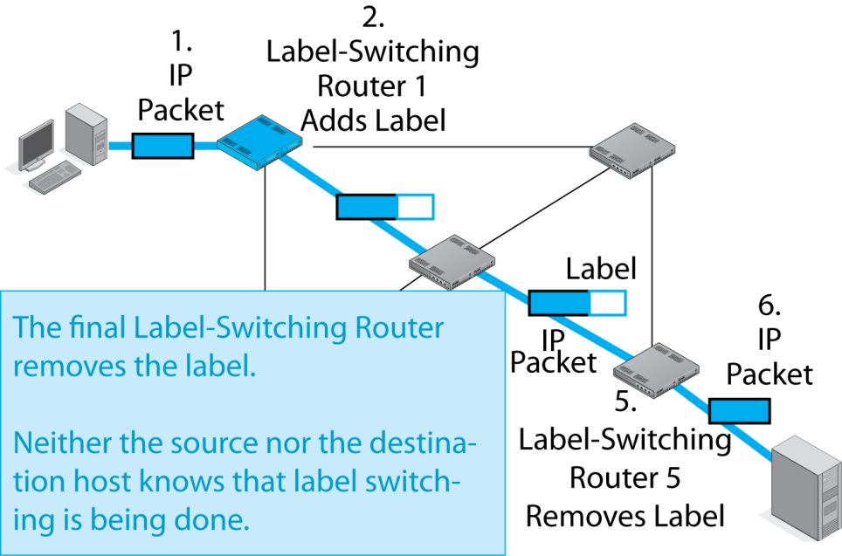
9.9: Multiprotocol Label Switching (MPLS)

Slide 168
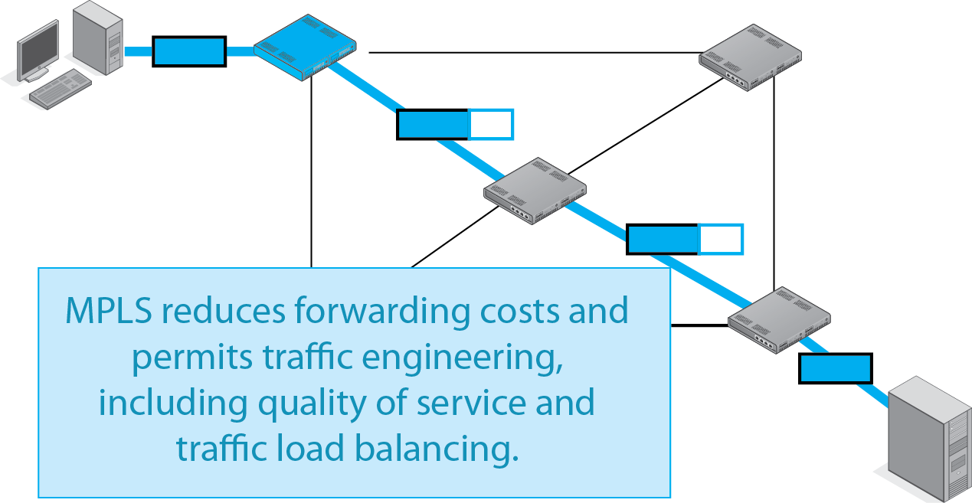
9.9: Multiprotocol Label Switching (MPLS)

Slide 169
9.9: Multiprotocol Label Switching (MPLS)
Implementing MPLS is difficult.
Many individual ISPs and corporations do it.
Some individual ISPs have “peering” arrangements with other individual ISPs to do it.
There is no general way to move MPLS out to all ISPs and organizations.

Slide 170
IP Subnetting
Network Address Translation (NAT)
DNS and DHCP
SNMP
Multiprotocol Label Switching
Securing Internet Transmission
IPv6 Management

Slide 171
Securing Internet Transmission
Security was not addressed in the initial design of TCP/IP.
Jon Postel, who edited the main Internet RFCs, explained to the first author, “It just wasn’t a problem then, and we were stretched thin.”
Today, firms are adding security to their transmissions through IPsec VPNs.

Slide 172
9.10: Virtual Private Network
A virtual private network (VPN) is a cryptographically secured transmission path through an untrusted environment.
The Internet
A wireless network
Communication in a foreign country
Like having your own private network in terms of security.
However, not a real private network.

Slide 173
IPsec VPNs

Slide 174
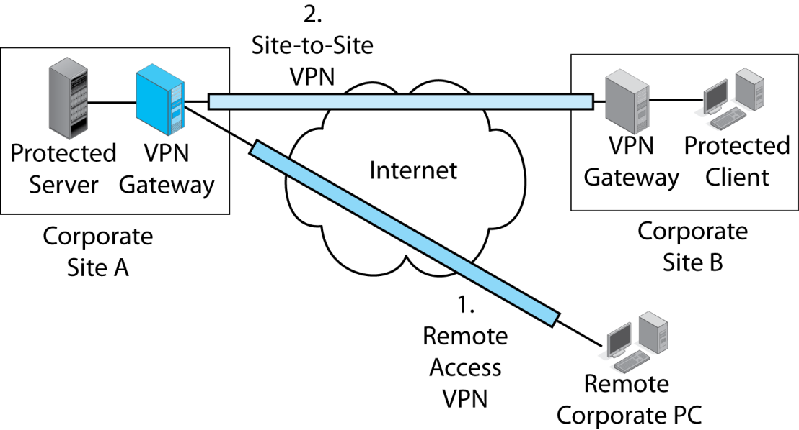
9.10: IPsec VPNs
There are two types of VPN:
Remote access VPNs connect a remote user to a corporate site.
The user connects to a VPN gateway at the site.

Slide 175
9.10: IPsec VPNs
There are two types of VPNs:
Site-to-site VPNs protect all traffic
traveling between two sites.
Each site has a gateway to encrypt outgoing traffic and decrypt incoming traffic.

Slide 176
9.11: IPsec in Transport and Tunnel Modes
IPsec has two modes (ways) of operating:
Transport mode
Tunnel mode
Each mode has strengths and weaknesses.
Selecting an IPsec mode option is very important to security.

Slide 177
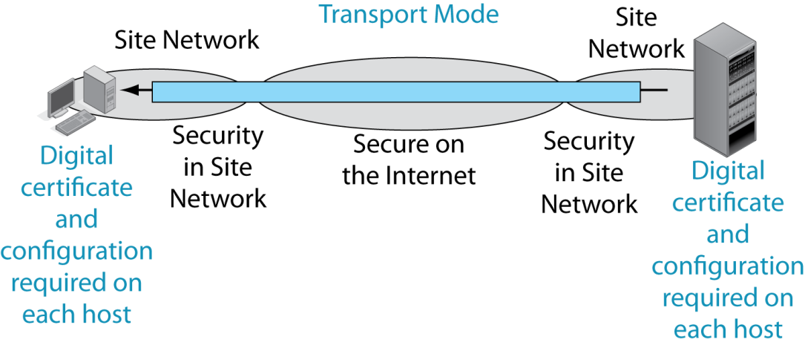
9.11: IPsec Transport and Tunnel Modes
In transport mode, IPsec provides protection over the Internet and also over site networks between the hosts.

Slide 178
9.11: IPsec Transport and Tunnel Modes
Transport mode requires a digital certificate and configuration work on each host. This is expensive.

Slide 179
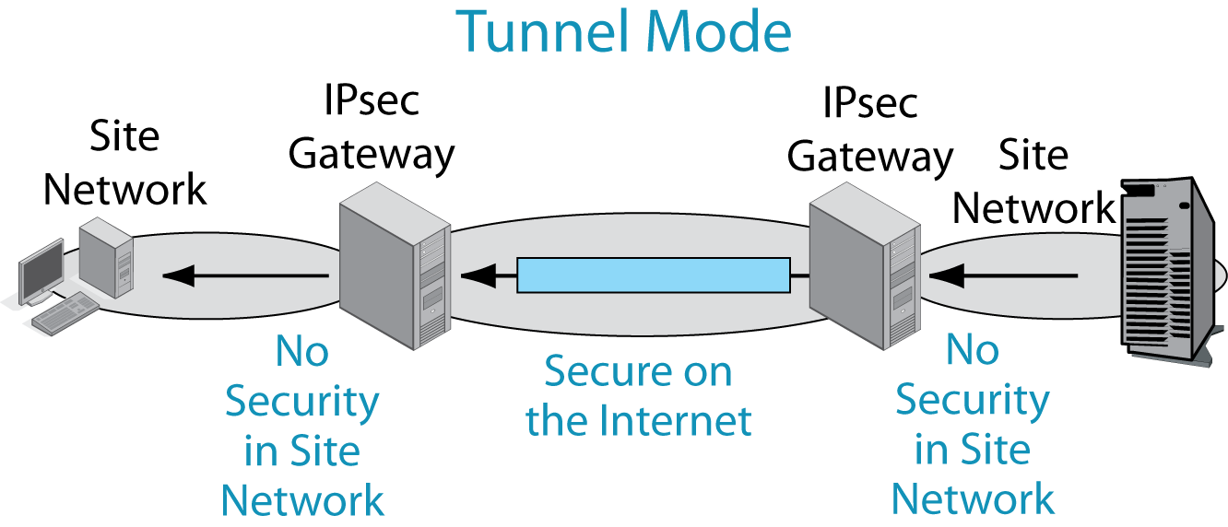
9.11: IPsec Transport and Tunnel Modes
In tunnel mode, IPsec only provides protection over the Dangerous Internet—not within site networks.

Slide 180
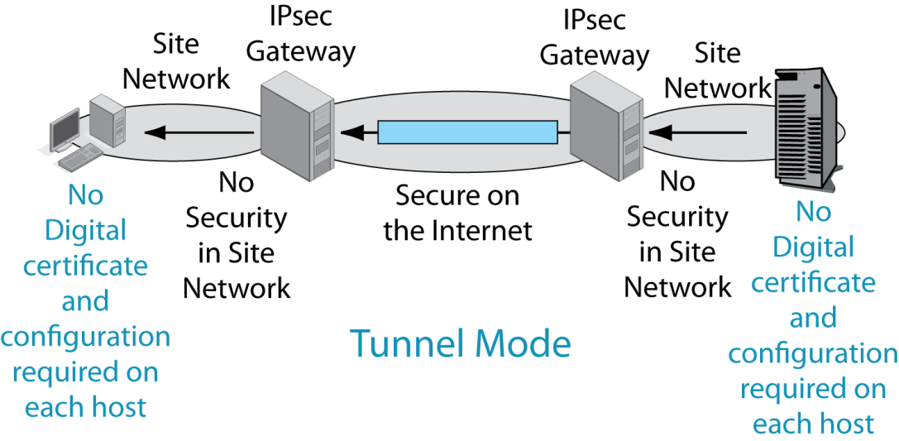
9.11: IPsec Transport and Tunnel Modes
Only the two IPsec gateways need digital certificates and configuration work.

Slide 181
9.11: IPsec Transport and Tunnel Modes
Criterion | Transport Mode | Tunnel Mode
Security | Better because it provides host-to-host protection. But firewalls cannot read encrypted traffic. | Not as good because it only provides security over the Internet or another trusted network (a wireless network, etc.).
Cost | Higher because of configuration work on each host. | Lower because IPsec operates only on the IPsec gateway .

Slide 182
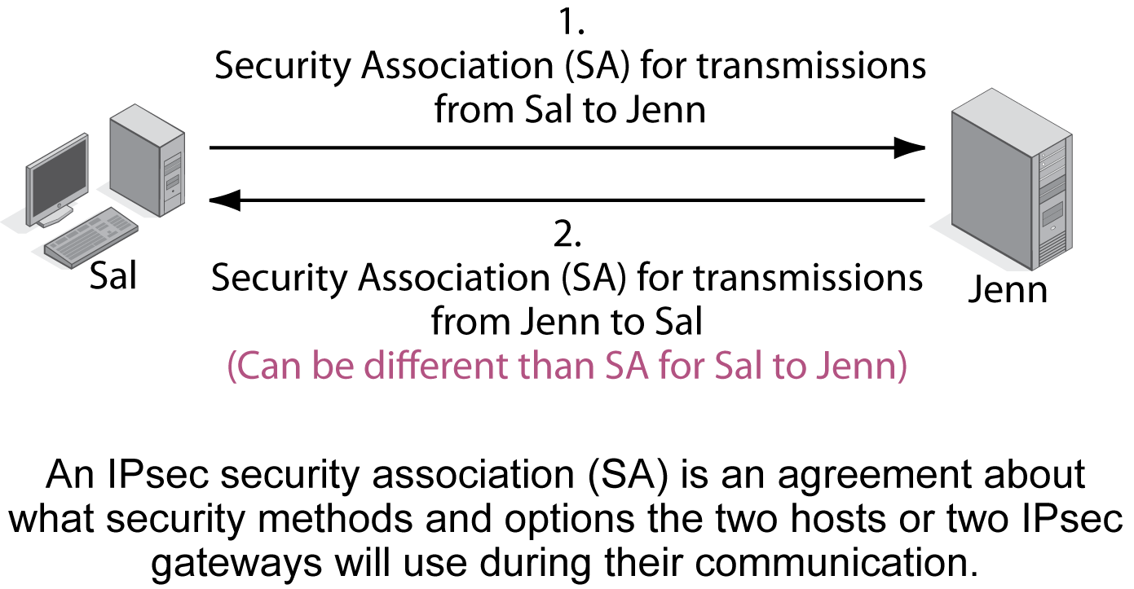
9.12: IPsec Security Associations and Policy Servers

Slide 183
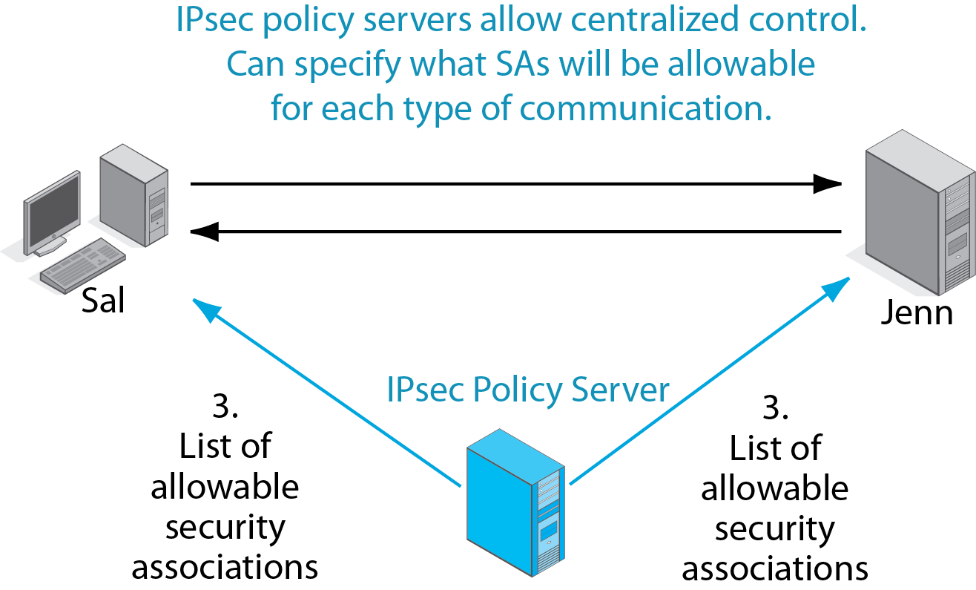
9.12: IPsec Security Associations and Policy Servers

Slide 184
SSL/TLS VPNs

Slide 185
9.13: SSL/TLS VPNs (Study Figure)
Purpose
To provide a secure connection between a client browser and a webserver application on a webserver host
Use is indicated by https:// in the URL
Very widely used

Slide 186
9.13: SSL/TLS VPNs (Study Figure)
Origin
Created by Netscape as SSL.
IETF took over the standard.
IETF changed the standard’s name to Transport Layer Security (TLS).
We refer to the standard, generically, as SSL/TLS.

Slide 187
9.13: SSL/TLS VPNs (Study Figure)
Attraction of SSL/TLS
Universally supported by browsers and webserver applications.
So no added cost on the client to use it!
No extra software on the server is needed, but SSL/TLS must be configured, which usually is simple.

Slide 188
9.13: SSL/TLS VPNs (Study Figure)
Limitations of SSL/TLS
Operates at transport layer so no protection for IP or transport headers
Limited to applications written to work with SSL/TLS: HTTP and e-mail, primarily
Cryptographically weaker than IPsec
Has been partially cracked
No policy servers for centralized management

Slide 189
9.13: SSL/TLS VPNs (Study Figure)
Overall
Decent quality, cheap, and easy security
Limited in how it can be used and managed
Comparison with IPsec
IPsec is more complex and so more expensive.
Can be used for all types of VPNs.
Can be managed well.
Gold standard in TCP/IP security.

Slide 190
IP Subnetting
Network Address Translation (NAT)
DNS and DHCP
SNMP
Multiprotocol Label Switching
Securing Internet Transmission
IPv6 Management

Slide 191
IPv6 Management Issues
Transition from IPv4 to IPv6
IPv6 subnetting
IPv6 configuration
Other IPv6 standards
ICMPv6
Extending DNS
Replacing the Address Resolution Protocol

Slide 192
Transitioning to IPv6
Must transition all clients, routers, firewalls, and so on
The IETF’s plan
No backward compatibility
Instead, add both IPv4 and IPv6 protocol stacks at the internet layer to all new devices
As soon as most devices have IPv6 protocol stacks, configure the devices and add IPv6 support to IPv4 support
Eventually, turn off IPv4 support

Slide 193
Transitioning to IPv6
Problems and reactions
IPv6 offered few benefits, so most companies ignored IPv6.
The shortage of IPv4 addresses was handled (intelligently) through NAT.
But now, IPv4 addresses are gone.
Now some clients, such as mobile phones, only have IPv6 stacks at the protocol layer.
To serve them, companies are rushing to turn on and configure IPv6 support.

Slide 194
Where We are Going
Chs. | Title | Layers
1-4 | Core Concepts | All
5-7 | Single Networks | 1 and 2
8-9 | Internets | 3 and 4
10 | Wide Area Networks | 1-4
11 | Networked Applications | 5

